Slide 1
Lead Scoring Case Study
By- Rahul Prakash

Slide 2
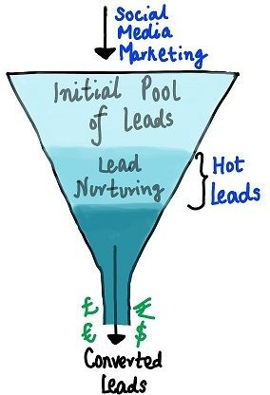
Problem Statement:
An education company named X Education sells online courses to industry professionals.
X Education gets a lot of leads, its lead conversion rate is very poor.
For example, if, say, they acquire 100 leads in a day, only about 30 of them are converted.
To make this process more efﬁcient, the company wishes to identify
the most potential leads, also known as ‘Hot Leads’.
If they successfully identify this set of leads, the lead conversion rate should go up as the sales team will now be focusing more on communicating with the potential leads rather than making calls to everyone.
Objective :
to help them select the most promising leads, i.e. the leads that are most likely to convert into paying customers.

Slide 3
Approach to the Solution:
Data Cleaning and Data Manipulation
Check and handle duplicate data.
Check and handle NA values and missing values.
Drop columns, if it contains large amount of missing values and not useful for the analysis.
Check and handle outliers in data.
EDA
Univariate data analysis: value count, distribution of variable etc.
Bivariate data analysis: correlation coefficients and pattern between the variables etc.
Feature Scaling & Dummy Variables and encoding of the data.
Classiﬁcation technique: logistic regression used for the model making and prediction.
Model Validation
Model representation.
Summary

Slide 4
Data Manipulation and Data Cleaning
There are total number of 9240 rows and 37 columns.
Dropped the “Prospect ID” and “Lead Number” as it was not necessary for the analysis.
Chain Content”, “Get updates on DM Content”, “I agree to pay the amount through cheque” etc. have been dropped.
The features that we have dropped include "Do Not Call," "What matters most to you in choosing a course," "Search," "Newspaper Article," "X Education Forums," "Newspaper," "Digital Advertisement," and others after examining the value counts for some of the object type variables.
Dropping the columns having more than 35% as missing value such as ‘How did you hear about X Education’ and ‘Lead Ǫuality etc.’.

Slide 5
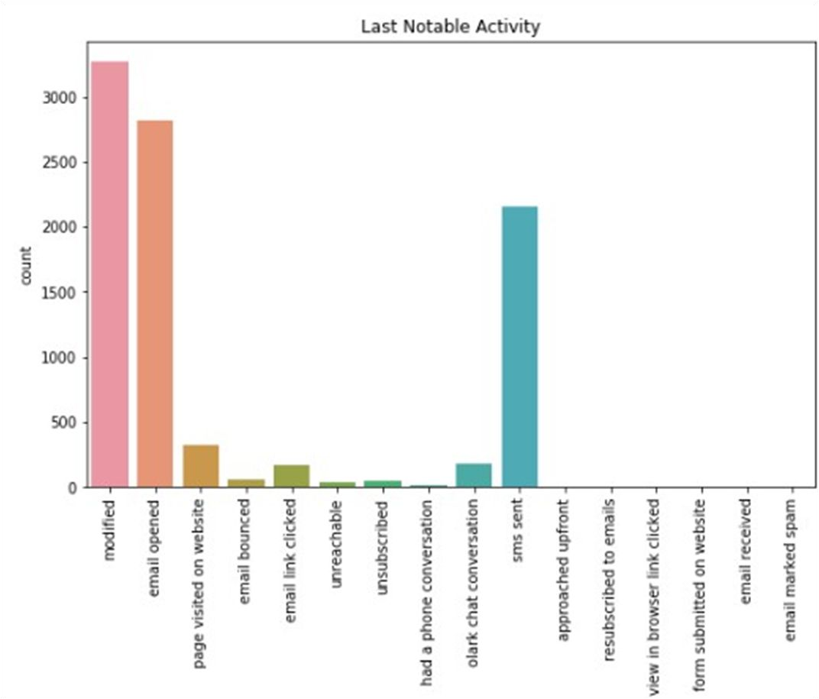
EDA

Slide 6
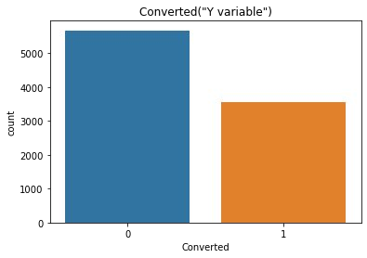
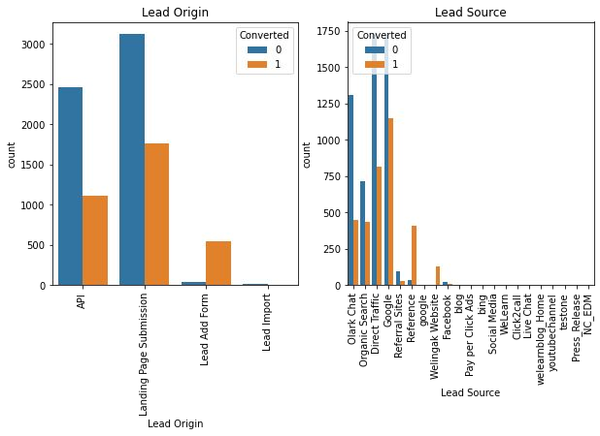

Slide 7
Correlation Among Variables

Slide 8
Data Conversion
Numerical variables were normalised
Dummy variables were created for object type variables
Splitting Data into Train and Test set.

Slide 9
Model Building
The first step for logistic regression is performing a train-test split, we have chosen a 70:30 ratio for our model
Use RFE for Feature Selection
Running RFE with 15 variables as output
Building Model by removing the variable whose p- value is greater than 0.05 and vif
value is greater than 5
Predictions on test data set
Overall accuracy 81%

Slide 10
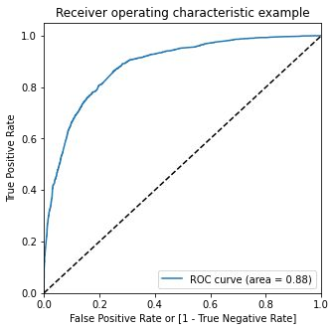
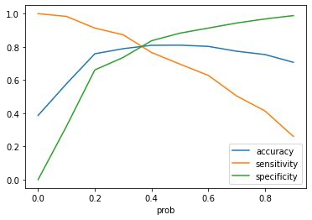
ROC Curve
Finding optimal cut-off point
Optimal cut off probability is that probability
where we get balanced sensitivity and speciﬁcity.
Here from the graph we can deduce that the optimal cut-off probability is 0.35

Slide 11
Summary
According to analysis, the following factors affected potential customers the most (in descending order):
Total time spent on the website overall.
number of visits overall.
If the lead came from one of the following:
Google;
Direct trafﬁc;
Organic search;
The Welingak website.
When was the last activity:
an SMS
A chat conversation on Olark?
when the Lead add format is the lead origin.
while they are a working professional at the time.
With these in mind, X Education can succeed since they have a very good probability of persuading nearly all prospective customers to change their minds and purchase their courses.

